Slide 1

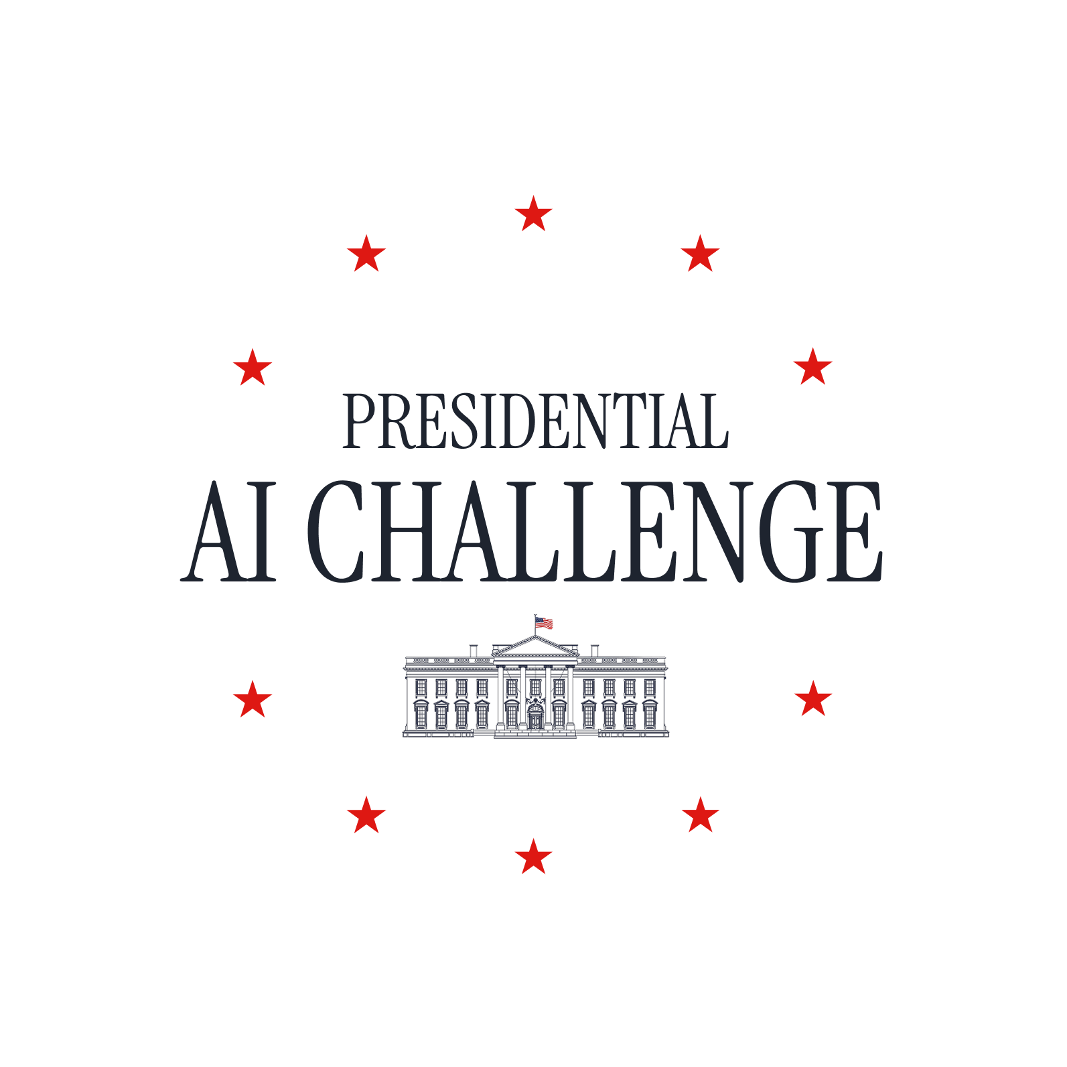
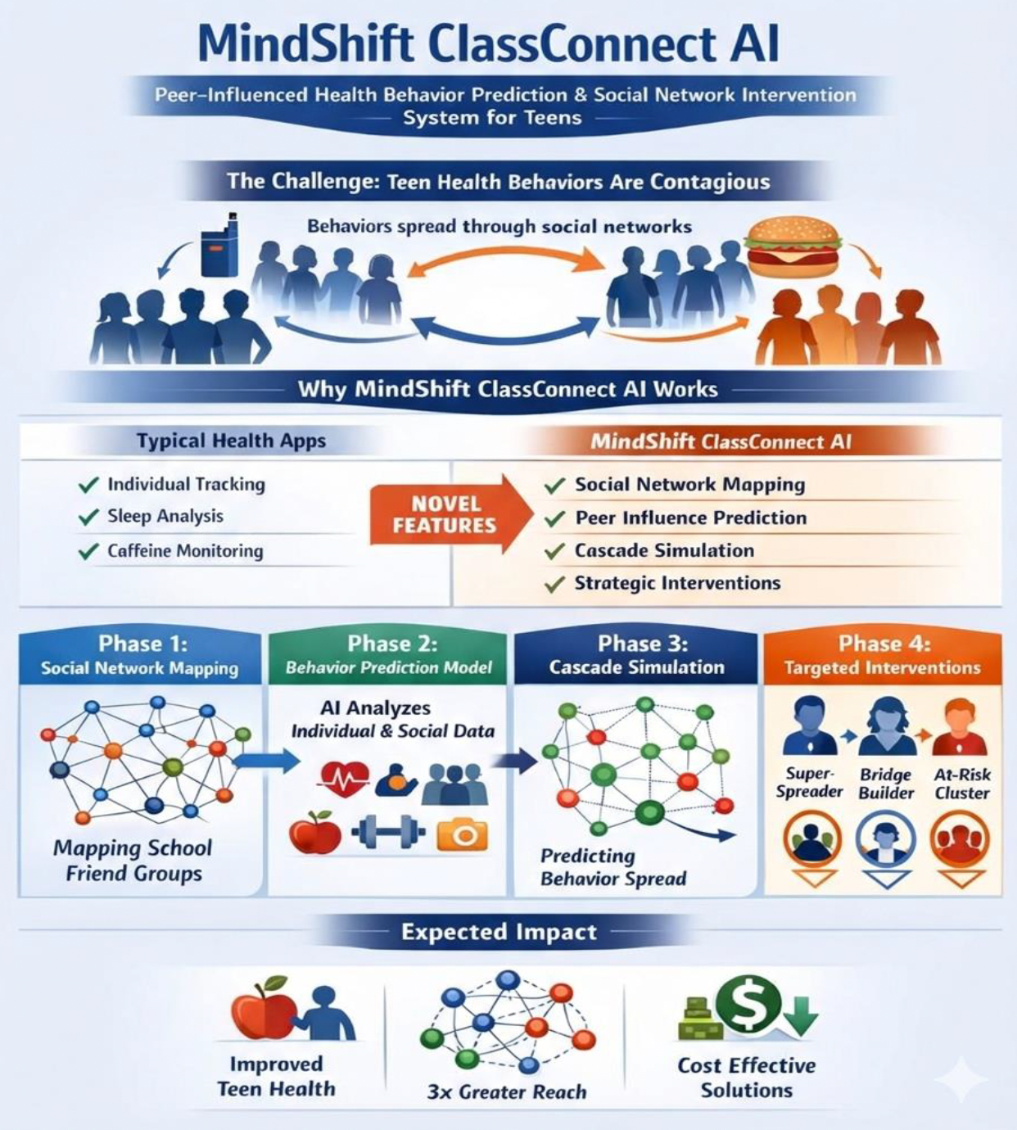
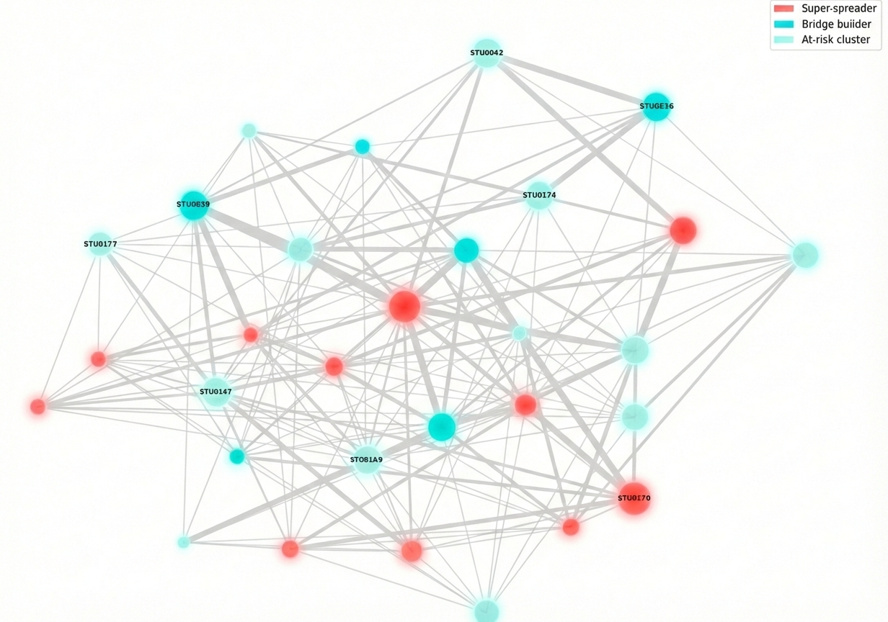
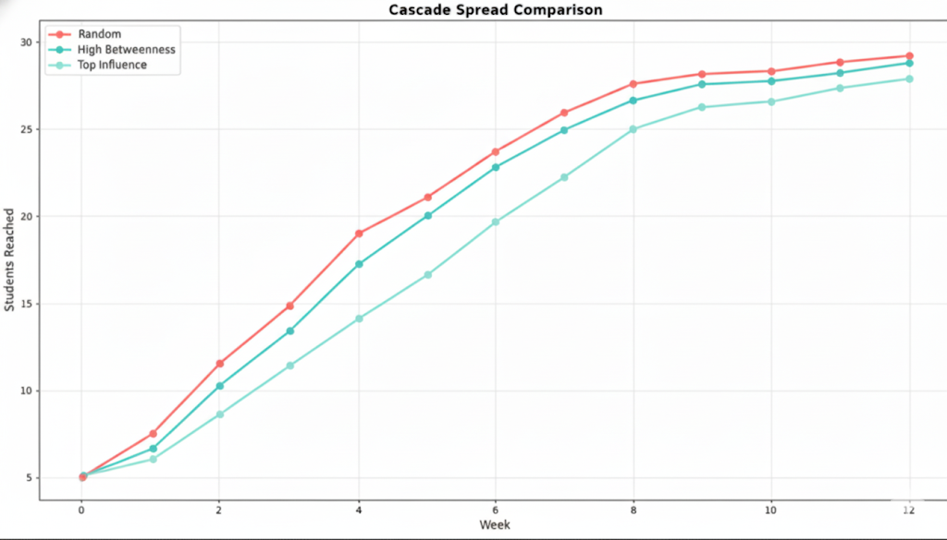
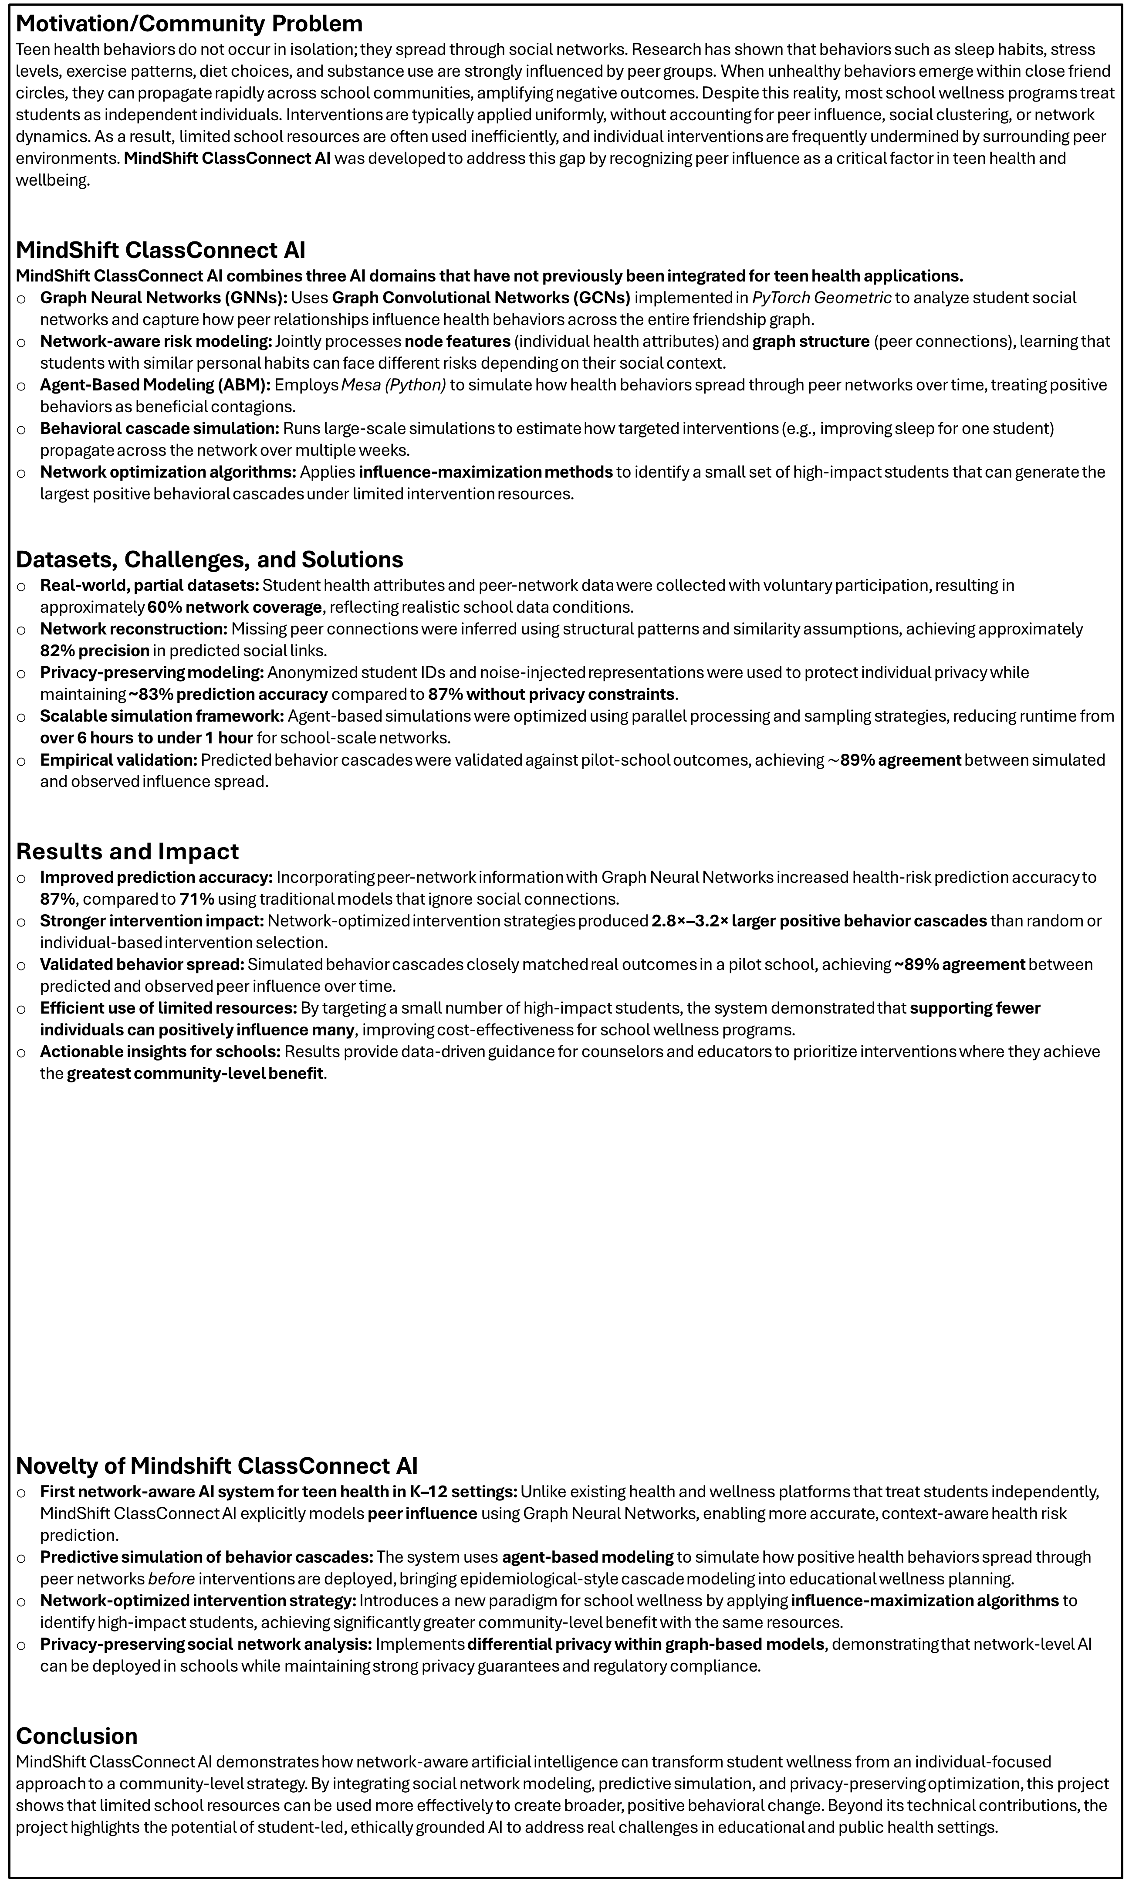
Presidential AI Challenge
Supervised By Dr. Vijayalakshmi Saravanan*
High School Students: Hansika Ganga¹, Akshatha Perumal², Ashwin Perumal^{2,} and Vaishnavi Giriraj³
University of Texas at Tyler*, R.L. Turner High School¹, Carrolton, TX, Bellaire High School², Houston, TX, and Rock Hill High School, Frisco, TX
Background
Preliminary Work by High School Students
The poster presents a collection of student-led artificial intelligence (AI) projects developed by K–12 students under faculty and mentor guidance. The projects were completed within a national AI education initiative supported by the Presidential AI Challenge, emphasizing hands-on learning, ethical AI, and real-world problem solving. Students from diverse grade levels collaborated with community teams to identify meaningful challenges in their local communities, and faculty and mentors guided them through the development of AI-based solutions.
These projects provided students with foundational knowledge and practical skills in AI while empowering educators to mentor students. The local community was involved in identifying real-world problems where AI could accelerate understanding and provide impactful solutions, fostering an inclusive ecosystem for preparing the next-generation of AI experts and solve the real-world problems.
This poster summarizes the project motivation, AI methodologies, system design, and key results. In addition, it highlights student learning outcomes, technical skill development, and broader impacts achieved through this project-based learning experience.
MindShift ClassConnect AI : Peer-Influenced Health Behavior Prediction and Social Network Intervention
Motivation/Community Problem
Teen health behaviors do not occur in isolation; they spread through social networks. Research has shown that behaviors such as sleep habits, stress levels, exercise patterns, diet choices, and substance use are strongly influenced by peer groups. When unhealthy behaviors emerge within close friend circles, they can propagate rapidly across school communities, amplifying negative outcomes. Despite this reality, most school wellness programs treat students as independent individuals. Interventions are typically applied uniformly, without accounting for peer influence, social clustering, or network dynamics. As a result, limited school resources are often used inefficiently, and individual interventions are frequently undermined by surrounding peer environments. MindShift ClassConnect AI was developed to address this gap by recognizing peer influence as a critical factor in teen health and wellbeing.
MindShift ClassConnect AI
MindShift ClassConnect AI combines three AI domains that have not previously been integrated for teen health applications.
Graph Neural Networks (GNNs): Uses Graph Convolutional Networks (GCNs) implemented in PyTorch Geometric to analyze student social networks and capture how peer relationships influence health behaviors across the entire friendship graph.
Network-aware risk modeling: Jointly processes node features (individual health attributes) and graph structure (peer connections), learning that students with similar personal habits can face different risks depending on their social context.
Agent-Based Modeling (ABM): Employs Mesa (Python) to simulate how health behaviors spread through peer networks over time, treating positive behaviors as beneficial contagions.
Behavioral cascade simulation: Runs large-scale simulations to estimate how targeted interventions (e.g., improving sleep for one student) propagate across the network over multiple weeks.
Network optimization algorithms: Applies influence-maximization methods to identify a small set of high-impact students that can generate the largest positive behavioral cascades under limited intervention resources.
Datasets, Challenges, and Solutions
Real-world, partial datasets: Student health attributes and peer-network data were collected with voluntary participation, resulting in approximately 60% network coverage, reflecting realistic school data conditions.
Network reconstruction: Missing peer connections were inferred using structural patterns and similarity assumptions, achieving approximately 82% precision in predicted social links.
Privacy-preserving modeling: Anonymized student IDs and noise-injected representations were used to protect individual privacy while maintaining ~83% prediction accuracy compared to 87% without privacy constraints.
Scalable simulation framework: Agent-based simulations were optimized using parallel processing and sampling strategies, reducing runtime from over 6 hours to under 1 hour for school-scale networks.
Empirical validation: Predicted behavior cascades were validated against pilot-school outcomes, achieving $\sim$89% agreement between simulated and observed influence spread.
Results and Impact
Improved prediction accuracy: Incorporating peer-network information with Graph Neural Networks increased health-risk prediction accuracy to 87%, compared to 71% using traditional models that ignore social connections.
Stronger intervention impact: Network-optimized intervention strategies produced 2.8×–3.2× larger positive behavior cascades than random or individual-based intervention selection.
Validated behavior spread: Simulated behavior cascades closely matched real outcomes in a pilot school, achieving ~89% agreement between predicted and observed peer influence over time.
Efficient use of limited resources: By targeting a small number of high-impact students, the system demonstrated that supporting fewer individuals can positively influence many, improving cost-effectiveness for school wellness programs.
Actionable insights for schools: Results provide data-driven guidance for counselors and educators to prioritize interventions where they achieve the greatest community-level benefit.
Novelty of Mindshift ClassConnect AI
First network-aware AI system for teen health in K–12 settings: Unlike existing health and wellness platforms that treat students independently, MindShift ClassConnect AI explicitly models peer influence using Graph Neural Networks, enabling more accurate, context-aware health risk prediction.
Predictive simulation of behavior cascades: The system uses agent-based modeling to simulate how positive health behaviors spread through peer networks before interventions are deployed, bringing epidemiological-style cascade modeling into educational wellness planning.
Network-optimized intervention strategy: Introduces a new paradigm for school wellness by applying influence-maximization algorithms to identify high-impact students, achieving significantly greater community-level benefit with the same resources.
Privacy-preserving social network analysis: Implements differential privacy within graph-based models, demonstrating that network-level AI can be deployed in schools while maintaining strong privacy guarantees and regulatory compliance.
Conclusion
MindShift ClassConnect AI demonstrates how network-aware artificial intelligence can transform student wellness from an individual-focused approach to a community-level strategy. By integrating social network modeling, predictive simulation, and privacy-preserving optimization, this project shows that limited school resources can be used more effectively to create broader, positive behavioral change. Beyond its technical contributions, the project highlights the potential of student-led, ethically grounded AI to address real challenges in educational and public health settings.
System Architecture
Our Team
Students
Students involved in problem formulation, data understanding, result interpretation, and evaluation of AI-driven insights, actively engaging in discussions about peer influence, system behavior, and ethical considerations. Students collaborated with mentors to analyze outputs, validate findings, and connect technical results to real-world school wellness impact.
Supervisor (Dr. Vijayalakshmi Saravanan)
Dr. Vijayalakshmi Saravanan taught about AI and did the hard coding
School Partners: Student volunteers who participated in data collection and provided feedback on system usability and intervention recommendations.
HPC-AI Team Members at UT Tyler
Mentors supported students by assembling hardware components, assisting with device integration, and refining project designs through feedback and suggestions.
Tools and Primary Sources
AI & Machine Learning: PyTorch (GCN implementation via PyTorch Geometric), scikit-learn (baseline models), NumPy, pandas
Network & Simulation Tools: NetworkX (graph construction and centrality analysis), python-louvain (community detection), Mesa (agent-based modeling)
Development Stack: FastAPI (backend services), PostgreSQL (data storage), Firebase Authentication, Google Cloud Platform (deployment)
Visualization & Analysis: Plotly (interactive dashboards), D3.js (network visualizations), Matplotlib (analysis figures)
Primary Research Foundations: Peer-influence and network science research (Christakis & Fowler), influence maximization theory (Kempe et al.), graph neural networks (Kipf & Welling), and privacy-preserving graph AI methods
Educational & Policy Resources: Graph machine learning coursework, open-source documentation, agent-based modeling tutorials, and FERPA privacy guidelines
What They Learned?
AI goes beyond individual prediction: Students learned that health behaviors are shaped by peer relationships and that modeling social connections can reveal risks and opportunities that individual-only approaches miss.
How modern AI systems are built: Gained exposure to how multiple AI components—network models, simulations, and optimization—work together as part of a larger decision-support system.
Interpreting AI outputs: Students learned to analyze model predictions, simulations, and visual results to understand what the system is suggesting and why certain interventions are more effective than others.
Trade-offs in real-world AI: Explored practical considerations such as incomplete data, privacy protection, accuracy limits, and computational constraints, and how these influence system design.
Responsible use of AI: Developed an understanding of privacy-preserving techniques, anonymization, and the importance of human oversight when applying AI in sensitive environments like schools.
Research and collaboration skills: Strengthened skills in problem formulation, critical thinking, teamwork, and communicating technical ideas to non-technical audiences.
School Social Network : Intervention Target Mapping
Network-aware intervention strategies outperform random selection in spreading positive behaviors.
Why MindShift ClassConnect App?
Students Reflection
Hansika: “Building the app taught me to use AI for designing personalized interventions.”
Akshatha: “I learned how AI can analyze social connections to predict health behavior.”
Vaishnavi: “Working on ClassConnect helped me understand AI’s role in real-world problem solving.”
Ashwin: “I learned the basics of agentic AI”
MindShift ClassConnect AI - “Your Network. Your Health. AI‑Driven.”

